Slide 1




Course name: Electrical & Electronics Systems(EE1002)
B.TECH FIRST YEAR
ACADemic YEAR: 2023-2024
Course code : EE1002
lecture series no : 04 (Four)
Credits : 4
Mode of delivery : OFF-line

Slide 2
Session outcome
“DC networks analysis & applications”

Slide 3
Assessment criteria’S
Assignment
quiz
mid term examination –I END TERM EXAMINATION

Slide 4

CO1 mapped with PROGRAM OUTCOMES MAPPING WITH [PO1],[PO2] , [PO3],[PO4],[PO7],[PO8]& [PO10]

Slide 5
Analysis of Electric Circuits
Source Transformation
Lecture
4

Slide 6
Contents
Analysis
of
Electric Circuits :
1. Sources
2. Source Transformation
Reference Books
–
–
–
Chapter 2-4 of Reference 1; [Hughes E]
Chapter 3 of Reference 2; [Nagasarkar & Sukhija]
Chapter 1-2 of Reference 3; [Kothari & Nagrath]
B Tech. 1st Year
Electrical & Electronics Systems (EE1002)

Slide 7
1. Basic circuit elements
•
Electric Circuit
–
An interconnection of simple electrical devices with at least one closed path
in which current may flow.
–
An Electric circuit is a mathematical model that approximates the behavior
of an actual Electrical system.
A combination of various elements (Resistor, Inductor, Capacitor, Voltage source, Current source) connected in any manner what so ever is called an electrical network.
–
B Tech. 1st Year
Electrical & Electronics Systems (EE1002)

Slide 8

•
Circuit Elements
–
Two terminal component that cannot be sub-divided
–
Described mathematically in terms of its terminal voltage & current
–
5 basic circuit elements
•
Active Elements
– Voltage and Current sources
Passive Elements
– Resistors, Inductors and Capacitors
•
B Tech. 1st Year
Electrical & Electronics Systems (EE1002)

Slide 9
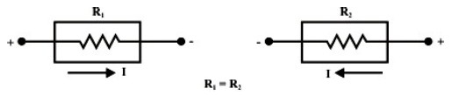
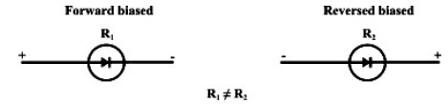
•
Passive Element : The element which receives energy (or absorbs energy) and
then either convert it into heat (R) or can be stored it in an electric
magnetic (L) filed.
(C) or
•
Active Element :
The elements that supply energy to the circuit.
Example: Voltage & Current sources
Transistor (can amplify power of a signal)
Note: Transformer is an example of passive element.
(Because it does not amplify the power level and
power
remains same both in primary and secondary sides)
•
Bilateral Element : Conduction of current in both directions in
same magnitude. Example: R, C & L
an
element with
•
Unilateral Element : Conduction of current in one directions.
Example: Diode, Transistor
B Tech. 1st Year
Electrical & Electronics Systems (EE1002)

Slide 10
Basic Circuit Elements
Active Elements
Passive Elements
Sources
Resistors
Inductors
Capacitors
Dependent sources
Independent sources
Voltage sources
Current sources
Ideal (DC) Voltage source
Practical (DC) Voltage source
Ideal (DC) Current source
Practical (DC) Current source
+
-
V
+
-
s
V
R
s
I
I
R
s
s
s
s
V
s
B Tech. 1st Year
Electrical & Electronics Systems (EE1002)

Slide 11
Passive Elements
Resistance (R): Property of opposition to flow of current
The voltage across the resistor is proportional to the current flowing through it ; V_{R} α I or V_{R} = IR, ‘R’ = V_{R}/I; Unit - Ohm
Inductance (L): Property of opposition to the rate of change of current
The voltage induced in the inductor is proportional to the rate of change
of current flowing through it;
e_{L} = L (di/dt) = N (dФ/dt); L = N (dФ/di); Unit – Henry (H)
Capacitance (C): Property which opposes the rate of change of voltage;
The capacitive current is proportional to the rate of change of voltage
across it ; i_{c} = C (dv/dt); Unit – Farad (F).
B Tech. 1st Year
Electrical & Electronics Systems (EE1002)

Slide 12
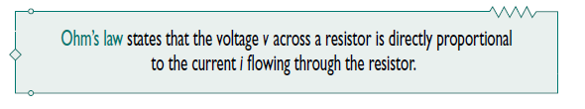
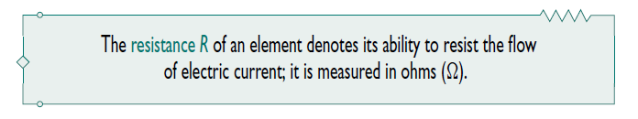
Ohm’s
Law
•
That is,
𝑣 ∝ 𝑖
Ohm (scientist) defined the constant
resistance, R.
•
of proportionality
for
a
resistor
to
be
•
Thus the above eq. becomes,
𝑣 = 𝑖𝑅
which is the mathematical form of Ohm’s law.
B Tech. 1st Year
Electrical & Electronics Systems (EE1002)

Slide 13


•
To apply Ohm’s law, we must pay careful attention to
voltage polarity.
the current direction and
•
^{The direction of current}
passive sign convention.
and
the
polarity
of
voltage
𝑣
must
conform
with
the
✓
This implies that current ﬂows
order for 𝑣 = 𝑖𝑅 .
from a higher potential to a lower potential in
✓
If current ﬂows from a lower potential to a higher potential, 𝑣 = −𝑖𝑅 .
B Tech. 1st Year
Electrical & Electronics Systems (EE1002)

Slide 14

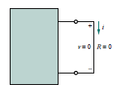
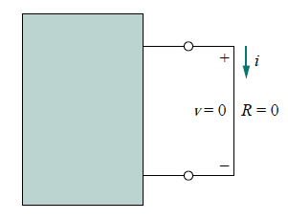

• Since the value of 𝑅 can range from zero to inﬁnity, it is important that we
consider the two extreme possible values of 𝑅.
•
•
An element with is called a short circuit, as shown in Fig.
For a short circuit,
𝑣 = 𝑖𝑅 = 0
showing that the voltage is zero but
the current could be anything.
•
In practice, a short circuit is usually a connecting wire assumed to be a
conductor.
perfect
B Tech. 1st Year
Electrical & Electronics Systems (EE1002)

Slide 15
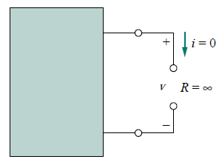

•
Similarly, an element with 𝑅 = ∞ is known as an open circuit, as shown in Fig.
•
For an open circuit,
indicating that the current is zero
though the voltage could be anything.
Note :
It should be pointed out that not all resistors obey Ohm’s law.
A resistor that obeys Ohm’s law is known as a linear resistor.
B Tech. 1st Year
Electrical & Electronics Systems (EE1002)

Slide 16
Problems
Q. A coil has a current of 50 mA flowing through it when the applied voltage is
12 V. What is the resistance of the coil?
Sol.
𝑅 = V/I
=
240𝛺
^{Q. A 100 V} battery is connected across a resistor and causes a current of 5 mA ^{to}
flow. Determine the resistance of the resistor. If the voltage is now reduced to
25 V, what will be the new value of the current flowing?
Sol.
𝑅 = V/I =
20𝑘𝛺
Current when voltage is reduced to 25 ,
I = V/R
=
25
= 1.25𝑚𝐴
20×103
B Tech. 1st Year
Electrical & Electronics Systems (EE1002)

Slide 17


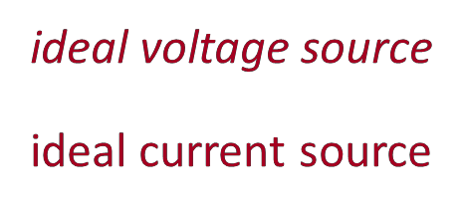
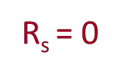
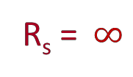
2. Sources
•
Ideal Nature
An ideal voltage source maintains a prescribed voltage regardless of
current in the device. Internal resistance R_{s} = 0
–
the
–
An ideal current source maintains a prescribed current
voltage across the device. Internal resistance Rs =
An ideal or practical source is called as ‘active element’
regardless
of
the
–
Note:-
B Tech. 1st Year
Electrical & Electronics Systems (EE1002)

Slide 18
•
Ideal Sources
•
Independent Voltage & Current Sources
– Circuit Representation
Ideal
Voltage Sources
V_{s}
(DC)
Ideal
Current
Sources
(DC)
+ -
Vs
Is
B Tech. 1st Year
Electrical & Electronics Systems (EE1002)

Slide 19
•
Practical Sources
•
Independent Voltage & Current Sources
– Circuit Representation
Practical Voltage Sources
Practical
Current
Sources
Vs
Rs
+
-
Is
Rs
B Tech. 1st Year
Electrical & Electronics Systems (EE1002)

Slide 20
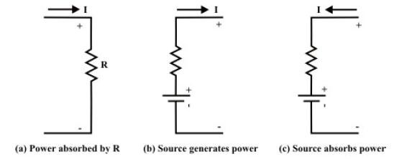
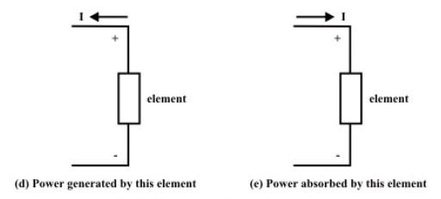
•
Understanding
Delivering
and
Absorbing
Power
by
the
Source
Fig. Source and Sink configurations
B Tech. 1st Year
Electrical & Electronics Systems (EE1002)

Slide 21
3. Source Transformation
Rs
⁺a
❑
Conversion of Practical Voltage source
to Current source & vice versa
+
-
Vs
- b
Voltage & Current
sources shown in
the figure are electrically equivalent if
⁺ a
Vs = Ip * Rp
R_{s} = R_{p}
or
(Ip = Vs/Rs)
Ip
Rp
-
b
B Tech. 1st Year
Electrical & Electronics Systems (EE1002)

Slide 22
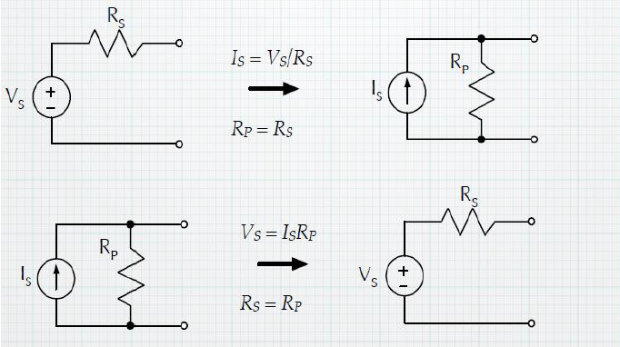
•
The
series
combination
seems
to
behave
identically
to
the
parallel
combination.
One can replace one configuration for switch is called source transformation.
•
the
other
where
needed.
And
this
B Tech. 1st Year
Electrical & Electronics Systems (EE1002)

Slide 23
Numerical Steps
Each of these circuits has a series parallel structure that makes it possible to simplify the circuit by the following steps:
•
• Performing source transformations.
• Replacing series or parallel resistors by an equivalent resistor.
• Replacing series voltage sources by an equivalent voltage source.
• Replacing parallel current sources by an equivalent current source.
Note:-
•
Each simplification is done in such a way that the voltage or current measured
by the meter is not disturbed.
•
Generally, that requires beginning the simplification at the opposite end of the
circuit from the meter and then working toward the meter.
B Tech. 1st Year
Electrical & Electronics Systems (EE1002)

Slide 24
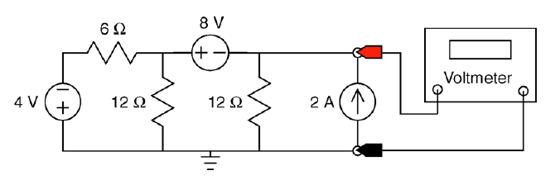
Worked Examples
Example 1
Consider the circuit
the voltmeter.
shown
in
Figure.
Find
the
value
of
the
voltage
measured
by
Figure 1 The circuit considered in Example 1
Solution:
The voltmeter measures the voltage across the current source.
B Tech. 1st Year
Electrical & Electronics Systems (EE1002)

Slide 25
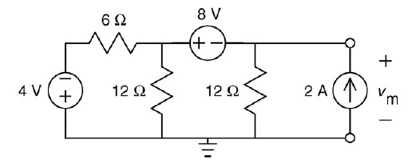
(The color-coded probes of the voltmeter indicate the reference direction of the
voltage measured by the voltmeter.)
Figure 2 shows the circuit after the replacing the voltmeter by the equivalent open
circuit and adding a label to show the voltage measured by the meter.
Figure 2 The circuit from Figure 1 after the replacing the voltmeter by an open
circuit.
B Tech. 1st Year
Electrical & Electronics Systems (EE1002)

Slide 26
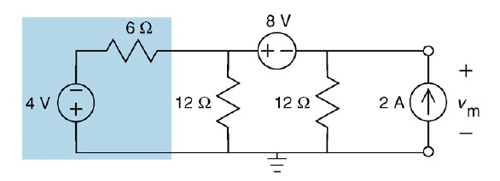
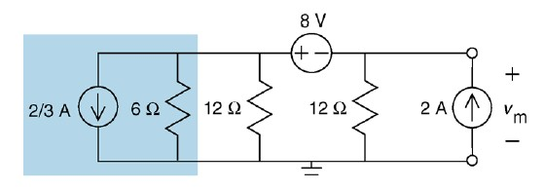
Figures 3 through 17 illustrate the
resistances to simplify the circuit.
use
of
source
transformations
and
equivalent
Figure 3 Separating the
circuit from Figure 2 into two parts.
Figure 4 The circuit from Figure 3 after doing a source transformation.
Electrical & Electronics Systems (EE1002)
B Tech. 1st Year

Slide 27
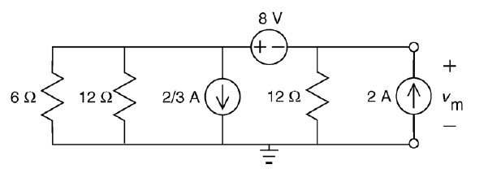
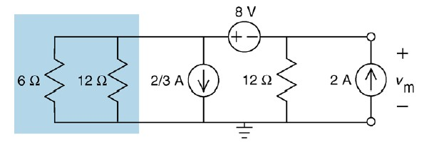
Figure 5 The circuit from Figure 4 after changing the order of parallel elements.
Figure 6 Separating the circuit from Figure 5 into two parts.
B Tech. 1st Year
Electrical & Electronics Systems (EE1002)

Slide 28
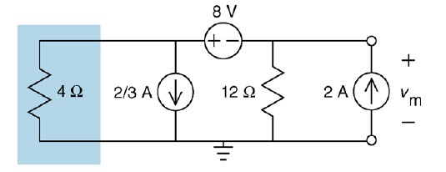
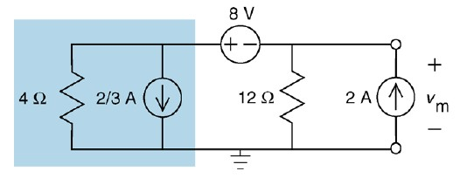
Figure 7 The circuit from Figure 6 after replacing parallel resistors with an
equivalent resistor.
Figure 8 Separating the circuit from Figure 7 into two parts.
B Tech. 1st Year
Electrical & Electronics Systems (EE1002)

Slide 29
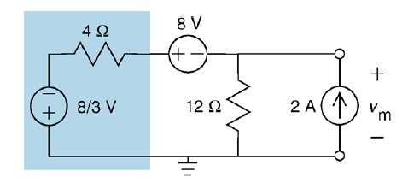
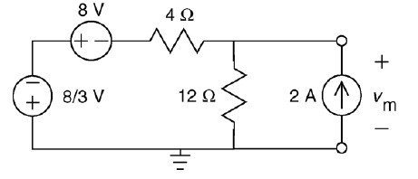
Figure 9 The circuit from Figure 8 after doing a source transformation.
Figure 10 The circuit from Figure 9 after changing the order of series elements.
B Tech. 1st Year
Electrical & Electronics Systems (EE1002)

Slide 30
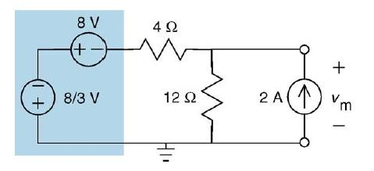
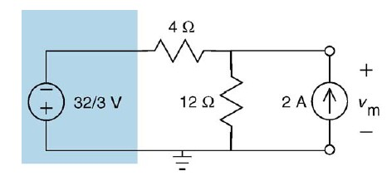
Figure 11 Separating the circuit from Figure 10 into two parts.
Figure 12 The circuit from Figure 11 after replacing series voltage sources with
an equivalent voltage source
B Tech. 1st Year
Electrical & Electronics Systems (EE1002)

Slide 31
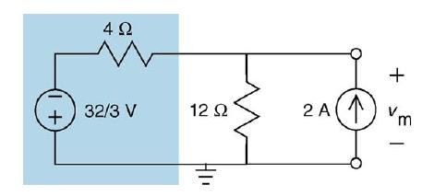
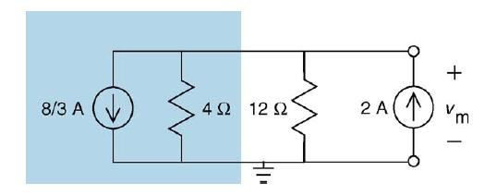
Figure 13 Separating the circuit from Figure 12 into two parts.
Figure 14 The circuit from Figure 13 after doing a source transformation.
B Tech. 1st Year
Electrical & Electronics Systems (EE1002)

Slide 32
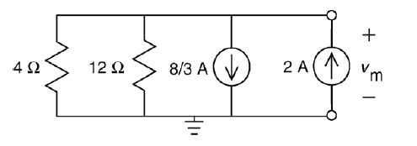
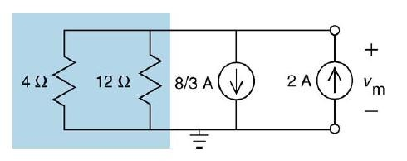
Figure 15 The circuit from Figure 14 after changing the order of parallel
elements.
Figure 16 Separating the circuit from Figure 15 into two parts.
B Tech. 1st Year
Electrical & Electronics Systems (EE1002)

Slide 33
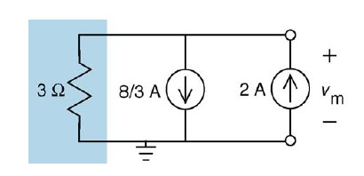
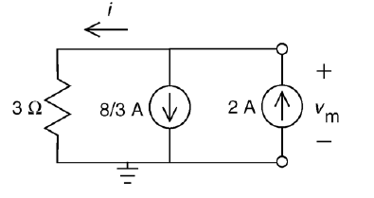
Figure 17 The circuit from Figure 16 after replacing parallel resistors with an
equivalent resistor.
Figure 18 The reduced circuit.
B Tech. 1st Year
Electrical & Electronics Systems (EE1002)

Slide 34
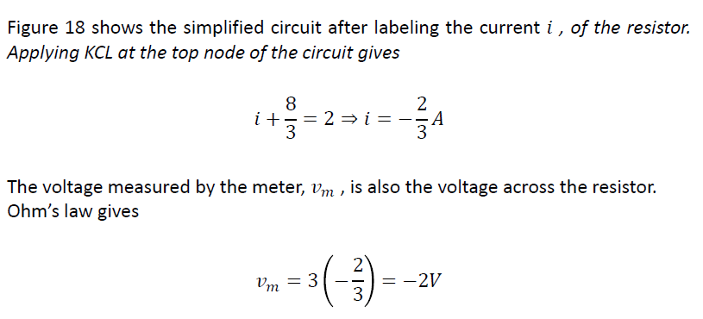
B Tech. 1st Year
Electrical & Electronics Systems (EE1002)

Slide 35
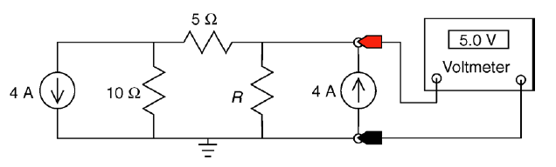
Example 2
Consider the circuit shown in Figure 19. Find the value of the resistance, R.
Figure 19 The circuit considered in Example 2.
Solution:
The voltmeter measures the voltage across one of the current sources.
Figure 20 shows the circuit after the replacing the voltmeter by the equivalent
open circuit and adding a label to show the voltage measured by the meter.
B Tech. 1st Year
Electrical & Electronics Systems (EE1002)

Slide 36
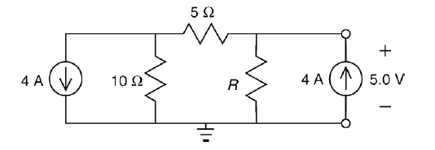
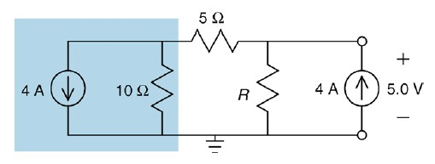
Figures 21 through 24 illustrate the
resistances to simplify the circuit.
use
of
source
transformations
and
equivalent
Figure 20 The circuit from Figure 19 after the replacing the voltmeter by an open
circuit.
Figure 21 Separating the circuit from Figure 20 into two parts.
B Tech. 1st Year
Electrical & Electronics Systems (EE1002)

Slide 37
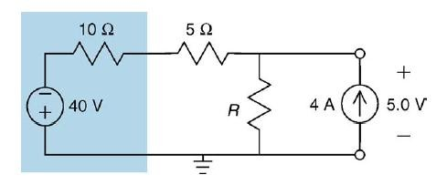
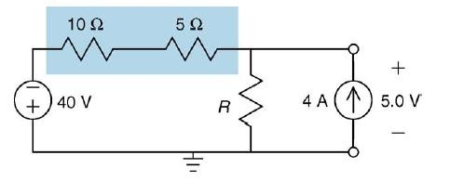
Figure 22 The circuit from Figure 21 after doing a source transformation.
Figure 23 Separating the circuit from Figure 22 into two parts.
B Tech. 1st Year
Electrical & Electronics Systems (EE1002)

Slide 38
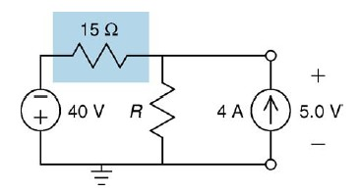
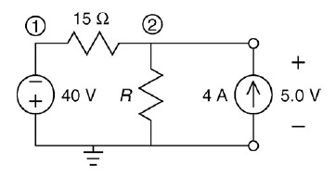
Figure 24 The circuit from Figure 23 after replacing series resistors with an
equivalent resistor
Figure 25 The circuit from Figure 24 after numbering the nodes.
Figure 25 shows the simplified circuit after numbering the nodes.
B Tech. 1st Year
Electrical & Electronics Systems (EE1002)

